Slide 1

University of Central Florida COP 3330 Object Oriented Programming

Slide 2
Graphical User Interface

Slide 3
Java Foundation Classes
JFC
a group of features to develop GUIs and adding graphics functionality and interactivity
Contains features
Swing GUI Components
Pluggable Look-and-Feel Support
Accessibility API
Java 2D API
Internationalization

Slide 4
Java Foundation Classes
Most of the code in this trail uses only one or two Swing packages:
javax.swing
javax.swing.event (not always required)
Swing API has 18 public packages
Commonly use only one or two Swing packages, javax.swing and javax.swing.event (not always required)
javax.accessibility | javax.swing.plaf | javax.swing.text
javax.swing | javax.swing.plaf.basic | javax.swing.text.html
javax.swing.border | javax.swing.plaf.metal | javax.swing.text.html.parser
javax.swing.colorchooser | javax.swing.plaf.multi | javax.swing.text.rtf
javax.swing.event | javax.swing.plaf.synth | javax.swing.tree
javax.swing.filechooser | javax.swing.table | javax.swing.undo

Slide 5
Top Level Containers
Swing provides three top-level container classes
JFrame
JDialog
JApplet
To display during runtime, every UI component must be part of a containment hierarchy, a tree of components that has a top-level container as its root
Each UI component can be contained ONLY once
If a component is already in a container and is then added to another container, the component will be removed from the first container and then added to the second

Slide 6
Top Level Containers
Each top-level container has a content pane that contains the visible components in that top-level container's UI
Optionally add a menu bar to a top-level container
The menu bar convention is positioned within the top-level container, but outside the content pane
Some look and feels, such as the Mac OS look and feel, gives the option of placing the menu bar in another place more appropriate for the look and feel, such as at the top of the screen

Slide 7
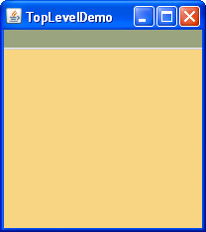
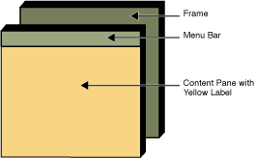
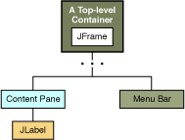
Top Level Containers

Slide 8
Top Level Containers
A program that use Swing components have at least one top-level container as the root of a containment hierarchy
As a rule, a standalone application with a Swing-based UI has at least one containment hierarchy with a JFrame as its root
An application has one main window and two dialogs, therefore the application has three containment hierarchies, (i.e. three top-level containers)
One containment hierarchy has a JFrame as its root and each of the other two has a JDialog object as its root
A Swing-based applet has at least one containment hierarchy, exactly one of which is rooted by a JApplet object
An applet that brings up a dialog has two containment hierarchies. The components in the browser window are in a containment hierarchy rooted by a JApplet object
The dialog has a containment hierarchy rooted by a JDialog object

Slide 9
Adding Components
Referencing the content pane
JFrame frame = new JFrame();
Label label = new Label();
frame.getContentPane().add(label);
The default content pane inherits from JComponent and uses BorderLayout as its layout manager
However, getContentPane() method returns a Container object not JComponent object
In order to use the content pane's JComponent features, it has to be typecast or create your own component to be the content pane

Slide 10
Adding Components
Setting the content pane using JPanel
JPanel layout manager by default is FlowLayout
use the top-level container's setContentPane method
Example
//Create a panel and add components to it.
JPanel contentPane = new JPanel(new BorderLayout());
contentPane.setBorder(someBorder);
contentPane.add(someComponent, BorderLayout.CENTER);
contentPane.add(anotherComponent, BorderLayout.PAGE_END);
topLevelContainer.setContentPane(contentPane);

Slide 11
Adding Menubar
All top-level containers can hold a menu bar
In practice, menu bars usually appear only in frames and applets
Add a menu bar to a top-level container
Create a JMenuBar object
Populate it with menus
Call setJMenuBar
Example
JFrame frame = new JFrame();
JMenuBar greenMenuBar = new JMenuBar();
frame.setJMenuBar(greenMenuBar);

Slide 12
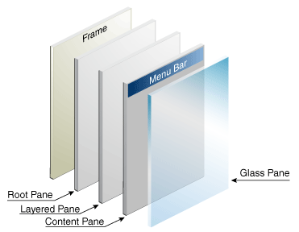
Root Pane
Each top-level container relies on a reclusive intermediate container called the root pane
Root pane manages the content pane and the menu bar in addition to a couple of other containers
Usually don’t be concerned with root pane but if need to intercept mouse clicks or paint over multiple components

Slide 13
Root Pane
The glass pane
Hidden, by default, if made visible it's like a sheet of glass over all the other parts of the root pane
Completely transparent unless you implement the glass pane's paintComponent method so that it does something, and it can intercept input events for the root pane
The layered pane
Serves to position its contents, the content pane and the optional menu bar.
Can hold other components in a specified Z order. For information
The content pane
The container of the root pane's visible components, excluding the menu
The optional menu bar
The home for the root pane's container's menus.
If the container has a menu bar, you generally use the container's setJMenuBar method to put the menu bar in the appropriate place

